Slide 1


Cognitive Psychology and the Salience of Austerity
Sorin Mitrea (McMaster University, Canada)
Austerity: Coping is Not Enough – February 21-22, 2019
Freidrich-Ebert-Stiftung, Berlin, Germany

Slide 2

Introduction
Austerity typically = policy practices to reduce deficits/debt;
AltAusterity’s goal: encourage debate among policy makers and influencers re: the assumptions, impacts, alts to austerity;
To achieve above, need to understand why austerity at times internalized as ‘common sense’;
Will examine cognitive dimensions to austerity, why it may become common sense, and how to encourage rational deliberation.
Notes:
- While in Canada austerity is arguably less salient than it was in the years after the 2008 financial crisis, public spending remains a perennial concern among the public, media, and policy makers despite evidence that austerity is harmful to growth and disproportionately hurts the disadvantaged

Slide 3
Presentation
Policy and political context of austerity in Canada;
Cognitive foundations of ‘common sense’ ideas;
The historical-cultural roots of austerity;
Approaches to ‘dislodging stuck ideas’.

Slide 4
Context of Austerity
Austerity = more than retrenchment
Canada: federal transfers restructured and reduced = subnational cuts
Also: P3s, privatization, outsourcing, corporate tax cuts/subsidies
Surface: less interest in austerity in Canada in past few years
Notes:
Austerity = redistribution benefits/burdens, alters scope of state’s involvement in economy/lives of citizens
Prov cuts to LMP, social assistance, education, health care; repeated
Overall = poorer LM outcomes, higher overall costs, lower overall effectiveness of policies REDUCES STATE’S CAPACITY IN REG, ENFORCE, S and LMP
Renewed interest post-2008
Arguments for: debt/deficits = slow growth, EFC

Slide 5
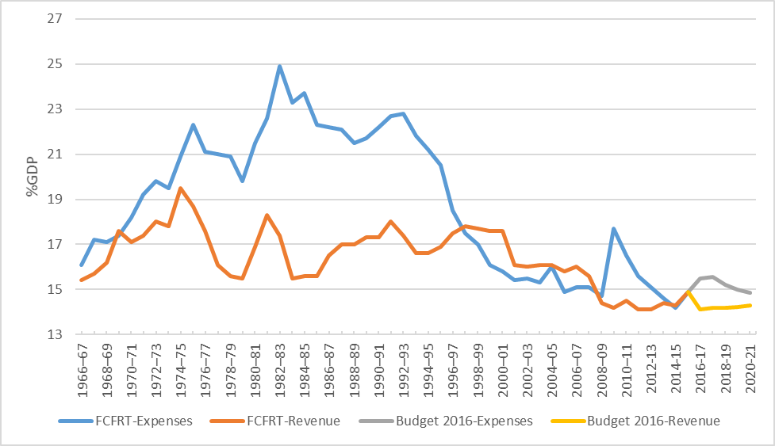
Notes:
Despite rhetorical and some policy resistance to austerity, structurally a clear trajectory since early 1990s
Federal expenses/revenues/projections as %GDP in $2016
Finance Canada Fiscal Reference Tables, Budget 2016, my calculations – needs updating, but was pressed for time
Rev %GDP from recent high of 19.5% 1974-75 to 14.3% 2014-15
Exp %GDP from recent high 24.9% GDP 1982-83 t o 14.2% 2014-15
Altogether = limit fed fiscal capacity and therefore reduced role in society, shaping scope/implementation/perhaps orientation of PP
NOT JUST CANADA 1) US 2018 tax cuts = 3.1tn in cuts in 2019; 2) EU austerity via European Semester, surveillance, eval, enforce e.g. limiting states’ structural deficits to 0.5%GDP

Slide 6
Cognitive Foundations of ‘Common Sense’
Info stored in memory as ‘schemas’ – shape how we perceive, evaluate, assume, interpret = basis of stereotypes, common sense;
Strong schema = multiple facets, more easily activated = automatic cognition;
If austerity repeated consistently = more likely to be internalized as ‘common sense’ (i.e. ‘automatic cognition’ or ‘automaticity’);
= impediment to rational deliberation because auto-cog is unconscious, has greater retention, harder to alter once learned, precedes + informs rational thought.
Notes:
- Schemas: interconnected nodes organizing information about anything we encounter in our environment, activated when triggered by stimuli, and potentially brought into short-term memory to inform thought, action, and feeling
For instance, if a person believes that debts should be repaid and that a household budget should be balanced, than they already believe aspects of austerity (at least as it is articulated in Canada).
as interconnected ideas repeated consistently through everyday interactions, media, politics
Strong ‘austerity schema’, the automatic thoughts, feelings, and behaviours embedded in that schema constitute a ‘common sense’ which would activate when an element of that schema is triggered, preceding or undermining rational deliberation.

Slide 7
Salience of Austerity
Auto-cog = how ‘common sense’ develops, but what is internalized also important to encouraging rational deliberation;
Austerity schema made up of concepts, feelings, reactions which may be informed by historically salient ideas…
Individual responsibility, reduced consumption, self-discipline, threat to individual/community;
Seen in: religion, healthcare, personal finance, personal health.
Notes:
Possible content of austerity schema in Canada+
PE + Judeo-Christian asceticism: 'thrift' (reduced and disciplined consumption/spending), 'self-reliance', 'industry' (individual responsibility and 'self-activation' to undertake hard work), and 'self-discipline‘
Healthcare: federal health minister argued that “fat Canadians imperil health care” because of the costs they ‘would incur’
Personal Finance: repeated cases arguing that “fat consumer debt [is the] biggest risk in Canada" and "similar with any diet…we advise Canadians to take a hard look at discretionary spending (improper consumption) and be prepared to make some tough choices on where to trim the fat"
Personal Health: obesity represents melancholy, excess, and lack of control and is often regarded as an individual moral failure

Slide 8
Salience of Austerity
Austerity discourses remain prevalent in Canada in politics, media, public opinion;
e.g. federal budgets of an ‘activist’ government, political campaigning, news stories on minutia of public spending;
Does not mean austerity is ‘common sense’ for all or that public spending is above scrutiny, but consistent repetition of similar ideas across time/contexts = greater chance of building strong austerity schema = impede rational deliberation on topic.
Notes:
Budgets: Budget 2017 stated that the government would be "investing in Canada in effective and fiscally responsible ways", in another case it referred to the “responsible spending proposed in budget 2017”
Campaigns: ON14 Liberal Party (‘centrist’) said, “government could be leaner” while the New Democratic Party (‘social democrat’) stated “if citizens are expected to tighten their belts … it’s only right that government does the same,”
Media: with titles such as “McKenna’s office spent $17k on Photographers for 15 Events” and “Tories Blast Liberals For Spending Too Much On Office Renovations And Trips” and other articles – from left of centre outlets - focusing on spending on renovations and travel
PO: August 2015 poll (shortly before the federal election) found that over 90% of people believe fiscal consolidation to be a top priority (Mainstreet 2015). In response to the 2017 budget, a poll showed that 80 percent of Canadians said that ‘having a plan in place to eliminate the deficit’ was important or somewhat important (Curry 2017).

Slide 9
Addressing Automatic Cognition
Insights from cognitive psych/therapy, social psych on schema change shown to weaken automatic cognition + encourage rational deliberation;
Overall, repetition + consistency of…
  Deficiencies of entrenched schema;
  Alternative schema;
  Metacognition.
Notes:
R&C: relatively coherent and limited range of responses to a relatively coherent and limited range of stimuli repeated consistently with positive or negative feedback; e.g. learning to drive by practicing, school, eval
Deficiencies: what are the false assumptions/negative effects of entrenched
Alternative:
Meta: dev individual awareness of cog/emotional processes = identify automatic cog, triggers, negative effects. FOUND to reduce racial bias and unfounded assumptions regarding climate change

Slide 10
Addressing Automatic Cognition
Specific mechanisms shown to be effective in modifying schemas without requiring sustained interaction;
Positive Affect
Politicization
Active Learning
Component Training
Notes:
Positive Affect has been shown to be more effective in reducing stereotype activation, building positive associations (e.g. with an alternative to austerity), and is less likely to trigger automatic resistance.
Politicization counters the potential belief that austerity is a ‘natural’ to response to many scenarios, outlining how it is a choice, not an inevitability. Draws attention to how austerity as discourses and policies result from power relations, permitting and discouraging certain responses to social challenges, and distributing benefits and burdens to different groups (thereby outlining its deficiencies as a political and cognitive schema).
Active learning refers to experiential learning processes which have been shown to improve learning outcomes and automaticity. Contact hypothesis demonstrates that stereotypes can be challenged through encounters with individuals who are disconforming from the stereotype.
Component training is the process by which abstract concepts are translated into clear rules, practices, and steps, and has been shown to improve understanding and automaticity.

Slide 11
Addressing Automatic Cognition
Association
Operant Conditioning
Modeling
Priming
Speaking to Values
Moderated Alternatives
Evidence & Expertise
Notes:
Association describes how individuals observe and internalize connections between ideas, actions, emotions, events, objects, and more (Snow 2006; Lodge & Taber 2005; North & Fiske 2012). In the context of austerity, associations between ideas, emotions, policies, and outcomes have coalesced and been repeated to inform austerity schemas – similarly, repeated associations will be central to alternative schemas.
Operant conditioning provides positive or negative reinforcement in response to certain behaviours, and can be applied directly or observed (Young 2007; Hewstone et al 2015; Bardi & Goodwin 2011).
Modeling describes how individuals reproduce actions and attitudes they observe, and is particularly effective when the model is seen to be authoritative or a member of an ‘in-group’ (a group an individual identifies with).
Priming describes how a stimuli activates schema(s) which remain in working memory and shape reactions to a different stimuli; e.g. an experiment primed individualistic or collectivist decision-making, which aligned with responses in a later value survey.
Speaking to Values in a positive way, rather than criticizing them, is important because values are strong, central schemas, and challenging them is more likely to result in resistance
Moderated alternatives based on studies which have shown that exposure to moderately disconforming information leads to greater stereotype change than exposure to extremely disconforming information
‘Evidence and expertise’ 1) cog psych/therapy indicates we must outline false premises and neg outcomes of maladaptive schemas; 2) evidence from ‘credible sources’ can improve likelihood of change, e.g. perceived experts and unbiased information BUT epistemic breaks

Slide 12
Application
Politicization + Evidence: KMb strategy;
Expertise + Modeling + Priming: communication products should be presented from multiple credible sources;
Alternatives + Positive Affect + Operant Conditioning + Component Training + Active Learning: products should draw contrasts between negative effects of austerity and potential positive effects of alternatives in an immersive, step-by-step way;
Values + Moderated Alternatives: values people associate with austerity should be reframed, not challenged directly and evidence against austerity should provide moderate criticism;
Repetition-Consistency + Association: repeat above to build positive associations with alternatives;
Metacognition: should attempt to provide audiences with skills to understand their ‘common senses’.
Notes:
A knowledge mobilization strategy should be developed to address the false assumptions, negative effects, and (counter)justifications of an austerity schema, including the fact that it is a policy decision, not an inevitability (‘politicization’, ‘evidence’);
Communication products, such as narratives, infographics, or interviews should be presented from multiple credible sources whom target audiences hold in positive regard (‘expertise’, ‘modeling’, ‘priming’);
These products should draw contrasts between the negative effects of the austerity schemas and the potential positive effects of an alternative in an immersive, step-by-step way (‘alternative schema’, ‘positive affect’, ‘operant conditioning’, ‘component training’, ‘active learning’);
However, the values people associate with an austerity schema should be reframed, not directly challenged (‘speak to values’). Similarly, evidence and products should provide moderate, rather than strong, criticism so as to reduce the chances of target audiences becoming more resistant (‘moderated alternatives’);
If the above steps are sustained (‘repetition and consistency’), there is a greater chance of making the entrenched schema vulnerable to change, connecting it with some negative information and alternatives with some positive information (‘association’);
Ideally, such a strategy should also attempt to provide target audiences with the skills to understand how ‘common sense’ operates and to encourage rational reflection (‘metacognition’).

Slide 13
Discussion
Complicating factors and possible directions:
  More research needed on how people understand austerity as policy/discourse;
  Schemas are social = biggest challenge is in-group echo chambers/epistemologies;
  Indirect value change cannot control motivation, openness, accuracy motivation, schema variations;
  Content informed by psych must be paired with targeted KMb, including coalitions;
  Any efforts to combat entrenched schemas must be done with consistency and repetition.
Notes:
Focus groups, surveys, and experiments measuring implicit attitudes (automaticity) could be conducted to reveal the constellation of ideas, values, affects, and behaviours that make up austerity schemas and how they may differ according to individual characteristics (age, education, gender, region, and more). These techniques can also be used to pilot alternative schemas and measure their effectiveness in changing values. However, responses in even mildly controlled environments can never be generalized perfectly to broader social settings

Slide 14
Join the Conversation
Learn about our project and see more of our research and media:
http://altausterity.mcmaster.ca/
https://twitter.com/altausterity
#altausterity

